Slide 1
7th Level
Medieval Minigolf
Development Team
Benjamin Ashton (Django Expert)
Erik Johnson (Backend Developer)
Jonathan Scoresby (Database Guru)
Jordan Taylor (Frontend Wizard)

Slide 2
Project Overview
Major Design Decisions
Adapting Agile Practices
Django: Web development framework to do a lot of heavy lifting such as authentication, unit tests, and database setup. Developers familiar with Django.
Scrum/Standup Meetings : Helped keep team members accountable and on track
Spring Plannings : Layed out a timeline to follow and keep the project on track
Bootstrap: Frontend framework that focuses on mobile support. Mobile accessibility desired by customer. The development team was also comfortable with implementing and using Bootstrap.
Product Backlog: List of current tickets/tasks to be focused on by the development team
Git: Used for version control as well as for tracking tasks/issues on a project board.
Agile Development: Smaller/Incremental portions of the project with regular feedback

Slide 3
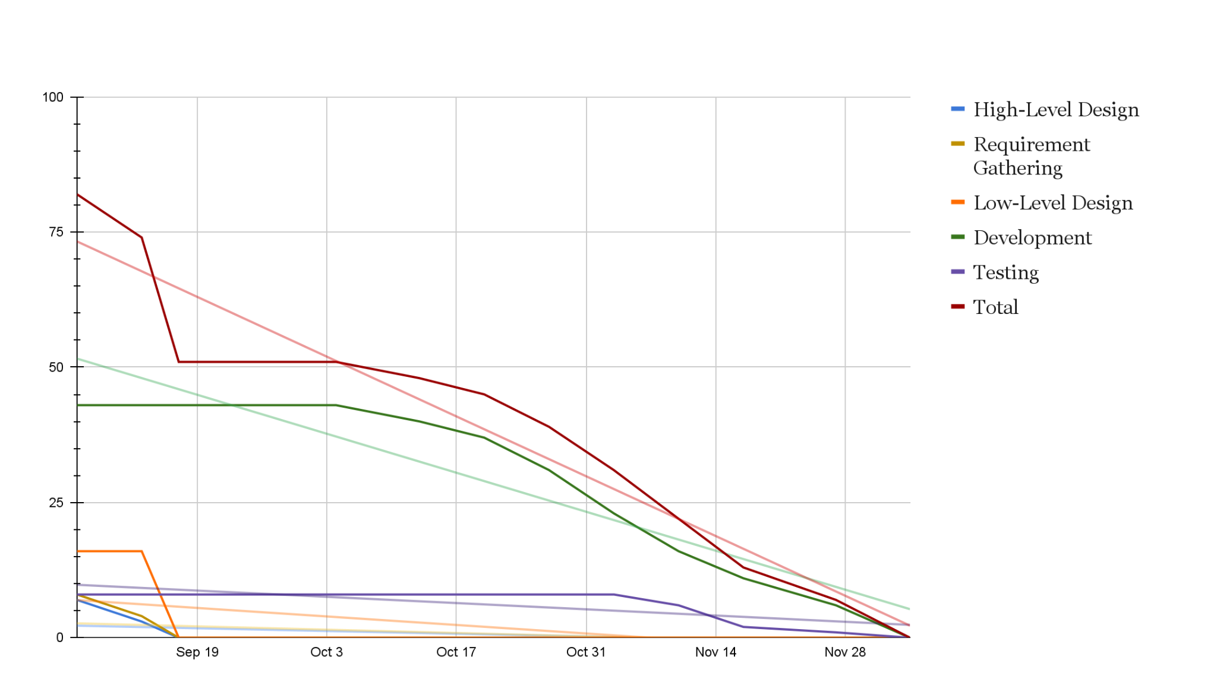
Burndown Chart
Total Story Points: 82
1 Story Point = 2 hours
Total Time = 164 hours
Approx. Time/Person = 41 hours
Estimation by hours seems a little low.
Estimated time to complete tasks improved throughout the project.

Slide 4
Sprint Pacing
Avg. Sprint Velocity = 13.66
Sprint 1 : 8 Story Points
Sprint 2 : 23 Story Points
Sprint 3 : 6 story Points
Sprint 4 : 14 Story Points
Sprint 5 : 18 Story Points
Sprint 6 : 14 Story Points
Milestone 1
Milestone 2
Milestone 3
Milestone 4

Slide 5
Project Ready
for Deployment
Requirements are met
Code/Project is Correct
Throughout development all must/must not requirements have been implemented
Consistent code reviews with each push made to the repository
Django unit tests written to ensure certain code/models are working
Steps have been taken to make installation/setup simple and reliable
Manual testing done to find bugs
Main functionality complete, further features can be added and released at a later date
All found bugs have been fixed
User-like testing completed to demonstrate use cases

Slide 6
Player Tracks Score
Requirements Definition:
2.2. Players must have the ability to keep track of their score on each hole.
2.3. Players should be able to view their ongoing score
2.7. Players should be able to view a leaderboard with all players and their scores

Slide 7
Player Tracks Score
Timeline
Milestone 1
Create use case diagram - Jordan Taylor
Milestone 2
Create activity diagram - Jordan Taylor
Create class diagram - Jonathan Scoresby
Milestone 3
Sprint 1
Basic Scorecard frontend and functionality - Jonathan Scoresby
Added Leaderboard page - Jordan Taylor
Sprint 2
Scorecard front-end styling - Jordan Taylor
Sprint 3
Scorecard fixes and added functionality - Jonathan Scoresby
Added Leaderboard functionality - Jonathan Scoresby
Milestone 4
Finalize functionality for Leaderboard and Scorecard - Jonathan Scoresby
Finalize design for Leaderboard and Scorecard - Jordan Taylor

Slide 8
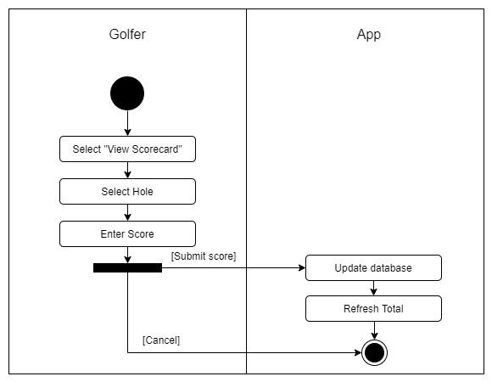
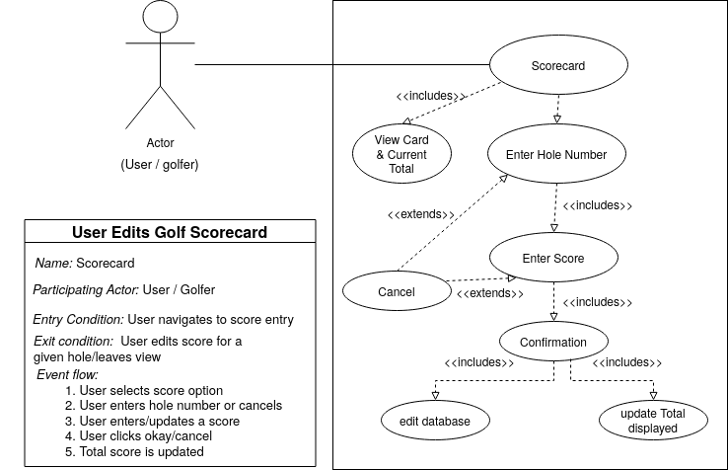
Use Case Diagram
Activity Diagram

Slide 9

Player Tracks Score

Slide 10
Manage User Type
From the requirements document:
Manager must be able to add/remove barista user
Manager must be able to add/remove sponsor user
Users could have a combination of the following access rights: Player, Barista, Sponsor, and Manager
Users with Player rights must have access to all Player features, See FR #2
Users with Barista rights must have access to all Barista features, See FR #3
Users with Sponsor rights must have access to all Sponsor features, See FR #4
Users with Manager rights must have access to all Manager features, See FR #5

Slide 11
Manage User Type
Overview and timeline of feature:
Milestone 1
Create use case diagram - Ben Ashton
Milestone 2
Create activity diagram - Jordan Taylor
Create class diagram - Jonathan Scoresby
Milestone 3
Sprint 1
Create user profile model with one-to-one relationship to default django user model - Jonathan Scoresby
User registration functionality - Benjamin Ashton
Sprint 2
Begin generic front-end layout and style - Jordan Taylor
Sprint 3
Improve style and layout - Jordan Tayor
Implemented basic user types and permissions as well as management feature - Benjamin Ashton and Jonathan Scoresby
Create initial test files - Jordan Taylor
Milestone 4
Finalize functionality as well as front-end layout - Jonathan Scoresby

Slide 12
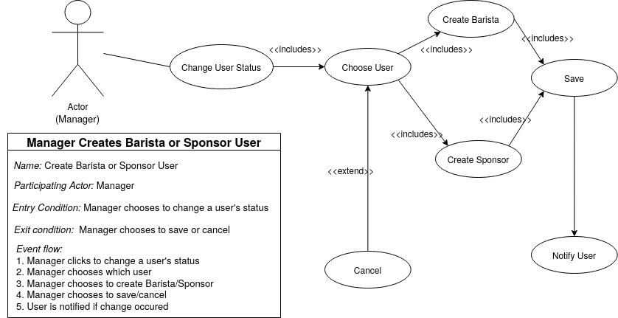
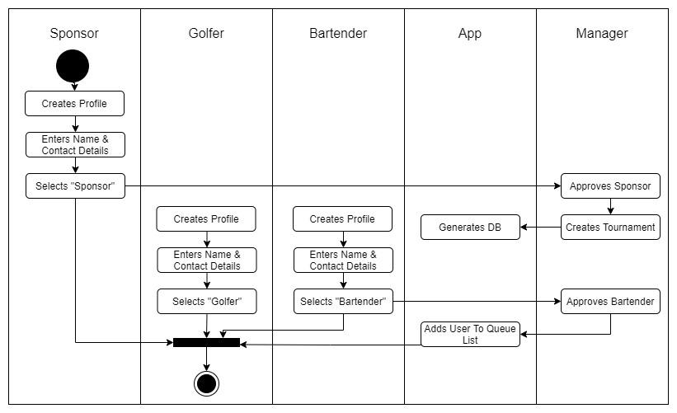
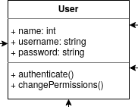
Manage User Type

Slide 13
Manage User Type

Slide 14
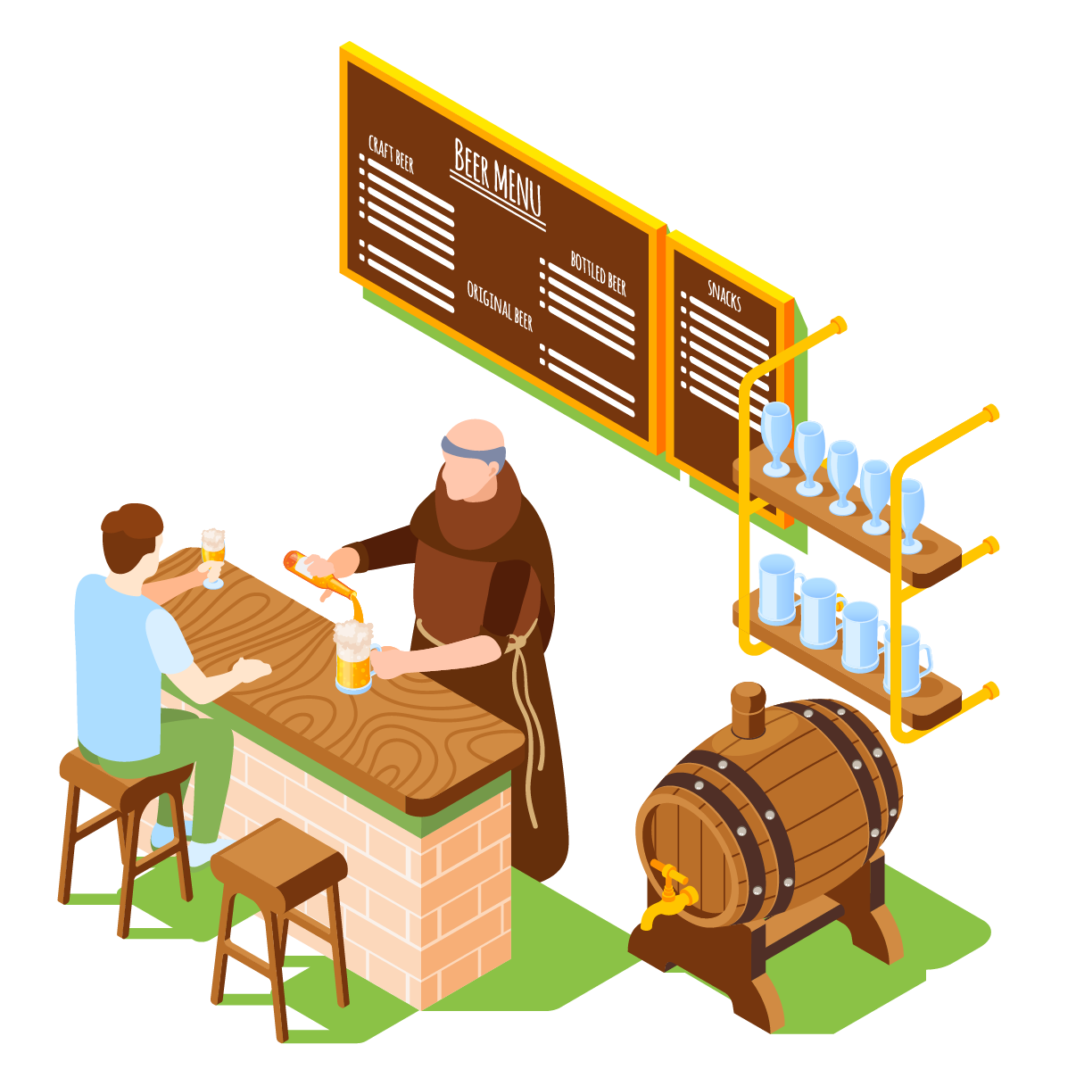
Player Orders Drink
Requirements Definition:
2.4 Players must be able to add funds into their account.
2.5 Players should be able to withdraw funds from their account.
2.6Players must have the ability to buy a drink while on the course.
Must have - database item, hole number field, select drink field, submit button, user’s name
Should have - Dynamic drink menu, User’s name automatically populated
Could have - Crispy form layout, Custom SVG illustration
Won't have (this time) - Toast/Snackbar notifications, SVG animation
@author: Jordan Taylor

Slide 15
Player Orders Drink
Functionality – The system allows the user to enter their current hole number (location) and to select a drink. The drink menu dynamically updates when the manager makes changes. On ordering, the system evaluates if the user has sufficient funds. A success message is displayed if so, otherwise the user is directed to deposit more funds.
Usability – Defines its aesthetics and accessibility, how the human and machine interfaces are accessed and laid out. How do other systems, processes or human users interact and use the new system?
The human interface is straightforward. The user selects “Order a Drink” from the player menu OR navigates to the Tavern tab. The options are clearly outlined. The machine serves an HTML page only if the user is authenticated.
Reliability – The insufficient funds error message clearly directs the user to specific steps. As long as the user is connected to the network, they will receive drink services. URL testing confirms page will be valid.
Performance – The system responds instantaneously when a drink is ordered, serving either success or error messages. This allows greater user efficiency.
Supportability – The menu page extends a base template page, allowing any styling changes to be global. The dynamic drink menu updates automatically when a new drink is added.
@author: Jordan Taylor

Slide 16
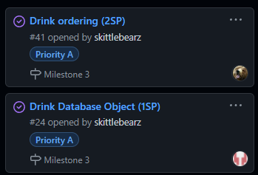
Player Orders Drink
Timeline
9/14 Erik created use case diagram
10/4 Erik uploaded the high-fidelity prototype
10/13 Jonathan created Django drinks model
10/25 Erik created drink menu page
10/26 Erik worked on ordering drink option
11/5-7 Erik continued drink menu
11/6 Jordan edited page layout
11/7 Jordan added user authentication to menu
11/12 Erik conducted drink unit testing
12/4 Jonathan added error/success messages
12/5 Jordan formatted error/success messages
@author: Jordan Taylor

Slide 17
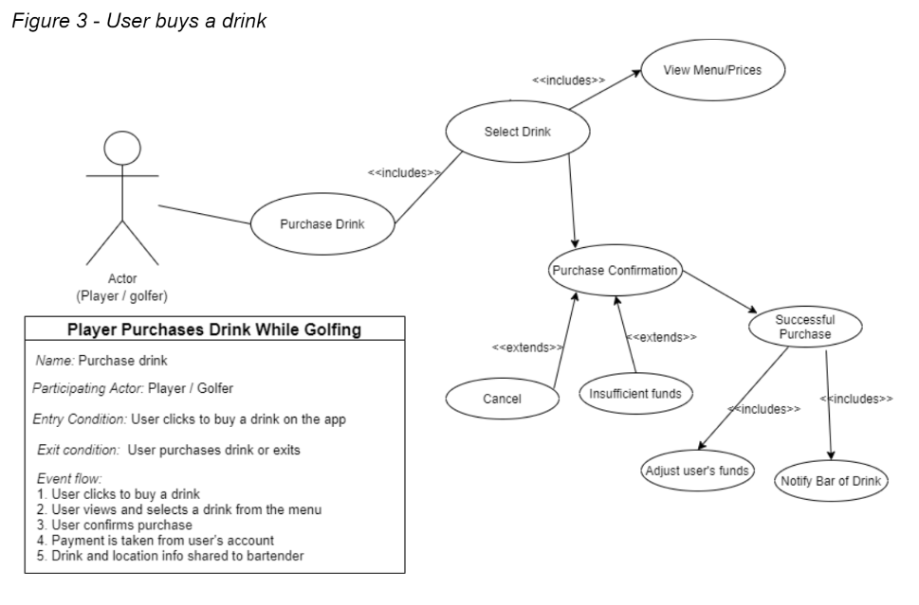
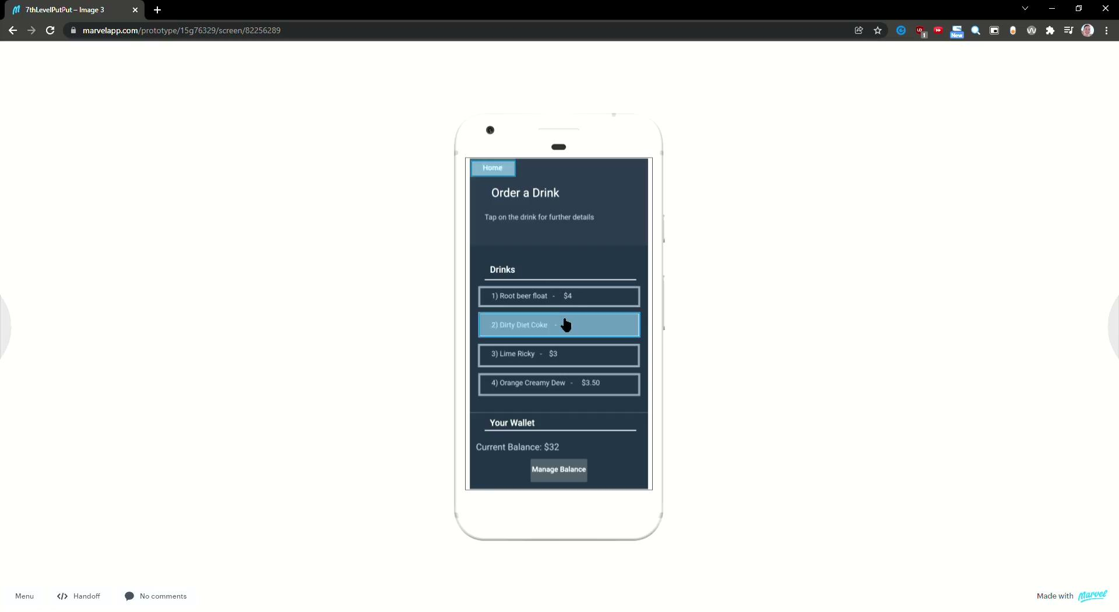
Player Orders Drink
Use Case Diagram
Hi-Fi Prototype
@author: Jordan Taylor

Slide 18
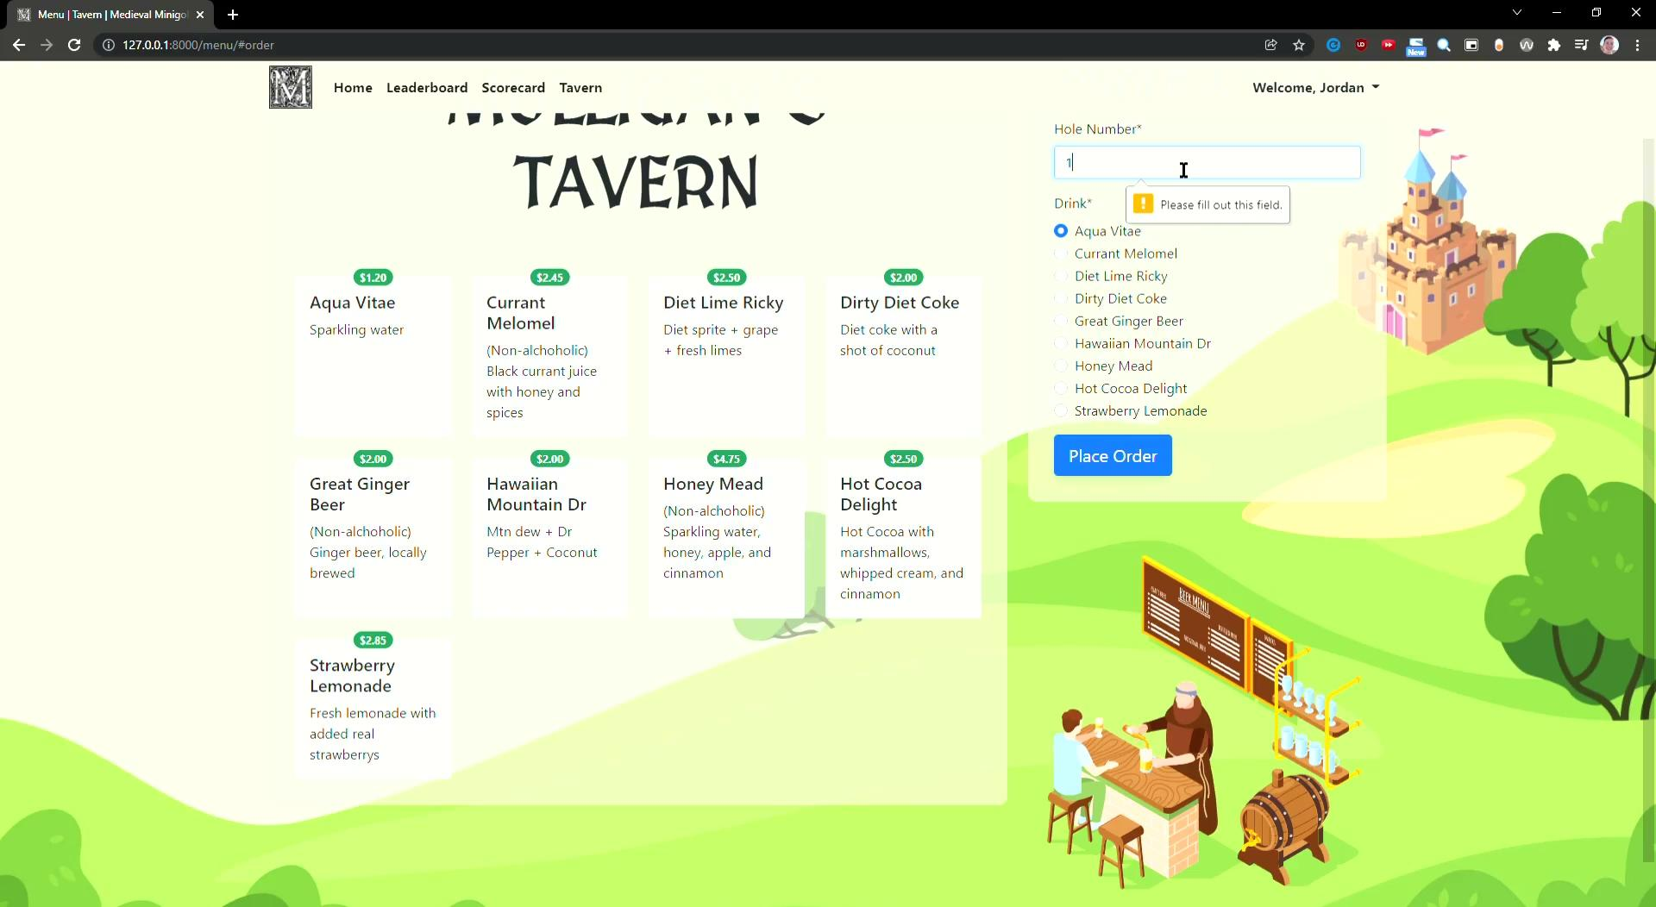
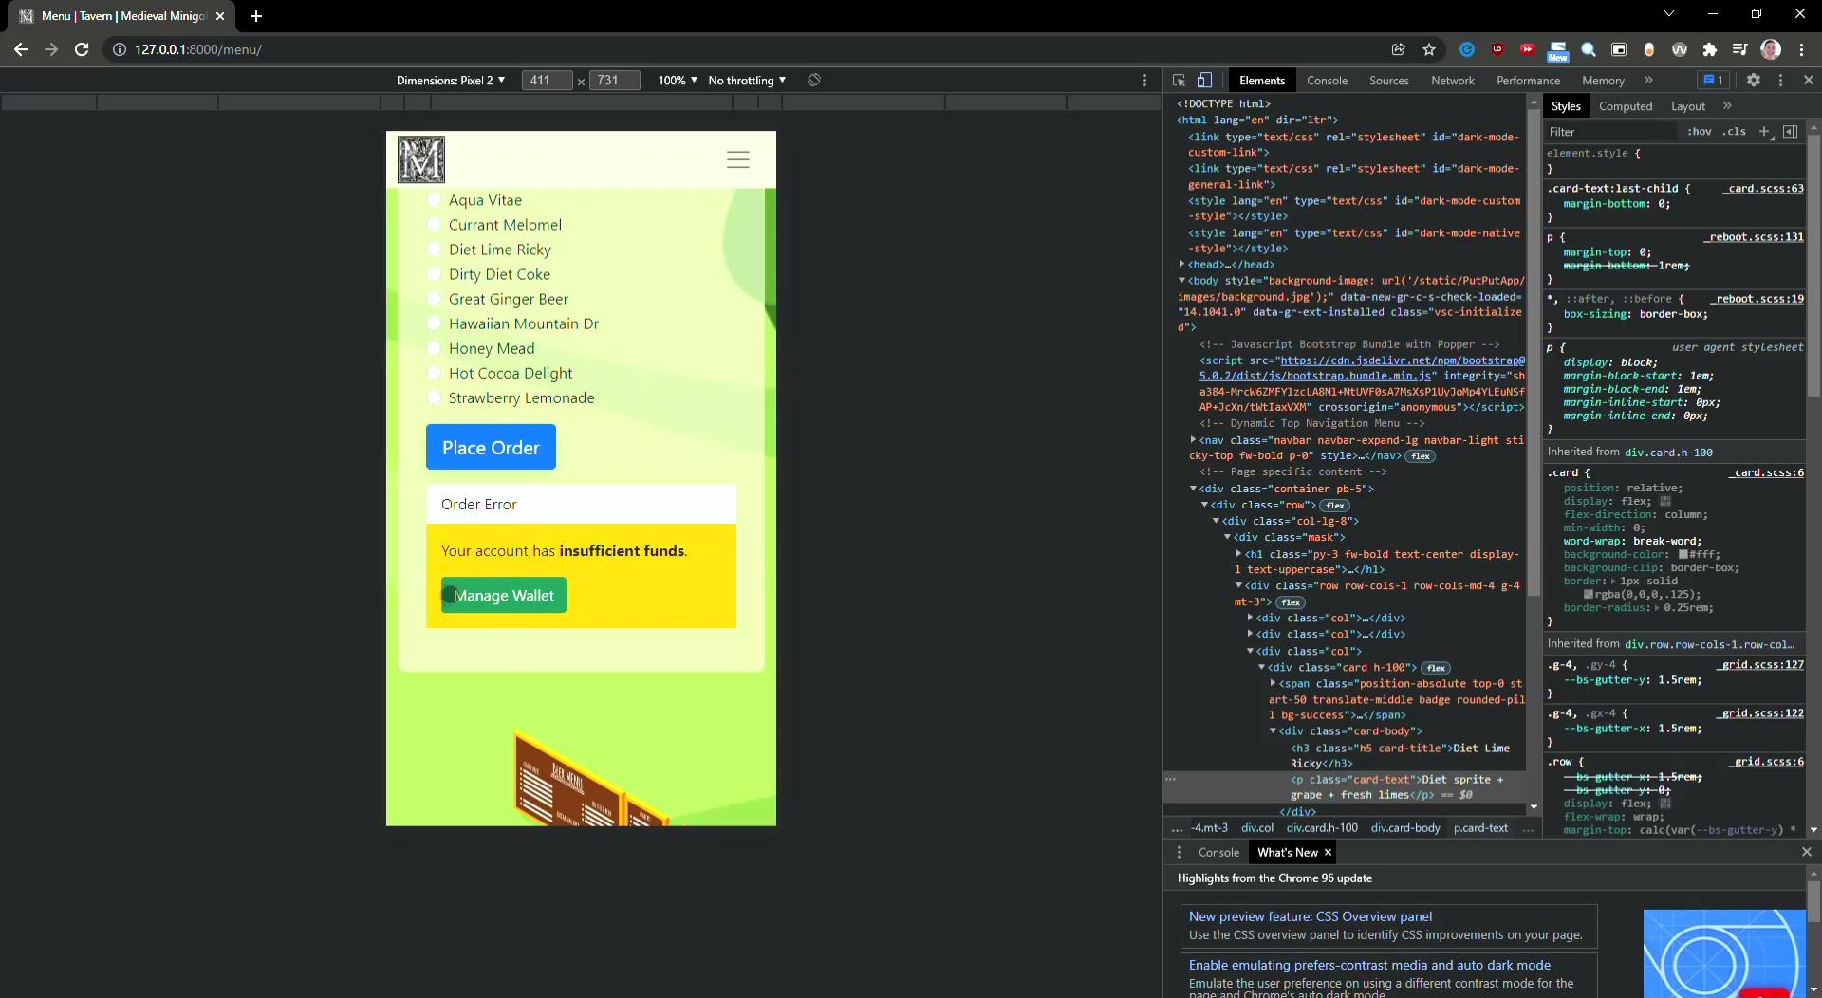
Player Orders Drink
Web View Demo
Mobile View Demo
@author: Jordan Taylor

Slide 19
Resources
Atlassian. (n.d.). What is agile? Atlassian. Retrieved December 5, 2021, from https://www.atlassian.com/agile.
Bootstrap Team. (n.d.). Introduction (Bootstrap 5). Retrieved December 5, 2021 from https://getbootstrap.com/docs/5.0/getting-started/introduction/
Django Software Foundation. (n.d.). Django Documentation . Retrieved December 5, 2021 from https://docs.djangoproject.com/en/3.2/
Django Software Foundation. (n.d.). Writing and running tests. Retrieved December 5, 2021 from https://docs.djangoproject.com/en/3.2/topics/testing/overview/
Django Software Foundation. (n.d.). Django User Management. Retrieved December 5, 2021 from https://realpython.com/django-user-management/
Extending Django User Model https://simpleisbetterthancomplex.com/tutorial/2016/07/22/how-to-extend-django-user-model.html#onetoone

Slide 20
Resources
cont’d.
Freitas, V. (8/13/2018). How to Use Bootstrap 4 Forms With Django. Retrieved December 5, 2021 from https://simpleisbetterthancomplex.com/tutorial/2018/08/13/how-to-use-bootstrap-4-forms-with-django.html

Slide 21
Questions?

